Slide 1
Annuities Session-I

Slide 2
Agenda/ Topics covered
Introduction to Annuities
Purpose of Annuities
Origin of Annuities
Types of Annuities
Annuities – New Business Process Flow
Annuities policy life cycle

Slide 3

Definition
An annuity contract is a legally enforceable written agreement under which an insurer is promises to make a series of periodic payments to a named person, starting on a specified date, in exchange for a premium or a series of premiums paid to the insurer.

Slide 4
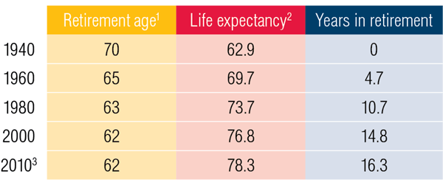
Retirement age & Life Expectancy

Slide 5
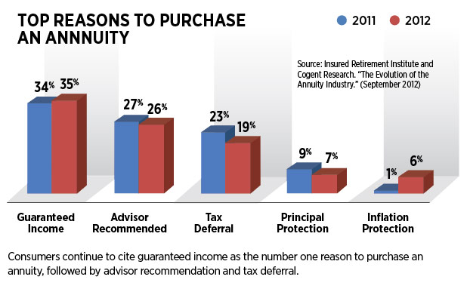

Slide 6
Purpose of Annuities
Annuities were originally created by life insurance companies to insure against “ superannuation, or the risk of outliving one's income stream.”
Modern annuity products can also help to pay disability, long-term care, and they can also serve as tax shelters for wealthy individuals whose incomes are too high to allow them to save money in other retirement vehicles

Slide 7


Slide 8
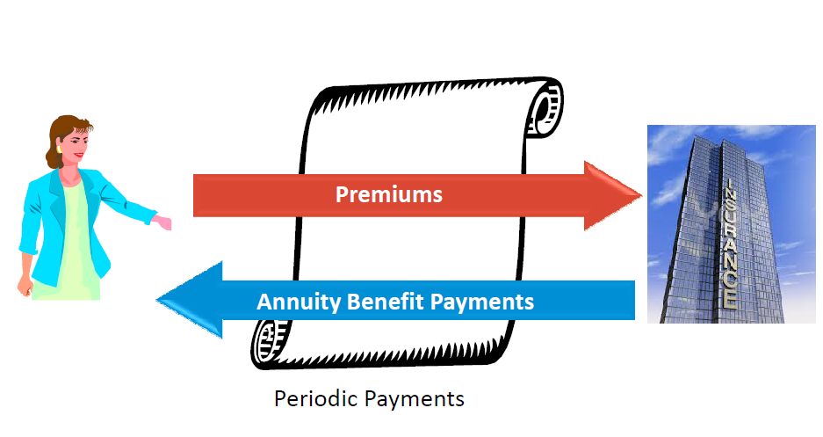
Parties to an Annuities Contract
The Parties to the Annuity contract are the insurer that issues the contract and the contract owner who applies for and purchases the contract.
Annuitant is defined as the individual upon whose life income benefits will be based.

Slide 9
History of Annuities
Although annuities have only existed in their present form for just a few decades, the idea of paying out a stream of income to an individual or family dates back to the Roman Empire.
The Latin word "annua" meant “annual stipends” and during the reign of the emperors the word signified a contract that made annual payments. Individuals would make a single large payment into the annua and then receive an annual payment each year until death, or for a specified period of time.
Roman soldiers were paid annuities as a form of compensation for military service. During the middle Ages, annuities were used by feudal lords and kings to help cover the heavy costs of their constant wars and conflicts with each other.

Slide 10
Types of Annuity Contracts
Annuity contracts can be categorized in a number of different ways, including according to:
When periodic income payments begin
How often premiums are paid
How annuity premiums are invested
A single annuity contract can fit into more than one category.

Slide 11
Types of Annuity Contracts
An annuity can be classified as an immediate annuity or a deferred annuity depending on when the insurer is to begin making periodic income payments.
Immediate annuity: provides periodic income payments that generally are scheduled to begin one annuity period after the date the contract is issued
In Immediate annuity payments are made at the end of successive period,
If the successive payments are made at beginning of the each successive period, then the annuity is called as Annuity Due.

Slide 12
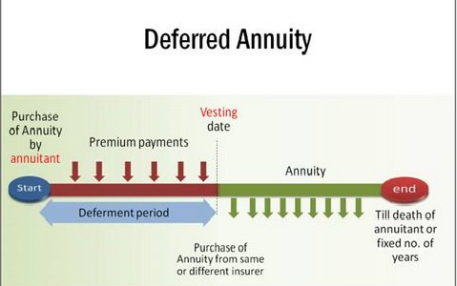
Types of Annuity Contracts
Deferred annuity: an annuity under which periodic income payments are scheduled to begin more than one annuity period after the date on which the annuity was purchased

Slide 13
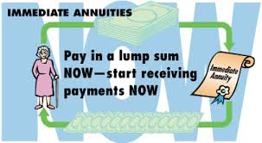

Immediate & Differed Annuities

Slide 14
Types of Annuity Contracts
The period between the contract owner’s purchase of a deferred annuity and the beginning of the payout period is known as the accumulation period.
(Accumulation value of a deferred annuity) = (Net amount paid for annuity) + (Interest ) – (Withdrawals)
Annuitization: exercising the right to receive periodic income payments from a deferred annuity

Slide 15
Types of Annuity Contracts
An annuity can be classified as either a single-premium annuity or a flexible-premium annuity according to how often premiums are paid.
Single-premium annuity: an annuity that is purchased by the payment of a single, lump-sum amount
Periodic income payments may begin shortly after the premium is paid or many years later.

Slide 16
Types of Annuity Contracts
Flexible-premium annuity: an annuity under which the contract owner pays premiums on a periodic basis over a stated period of time
The amount of each premium payment can vary between set minimum and maximum amounts, such as any premium amount between $250 and $10,000 each year.
The contract owner can also choose not to pay any premium in a given year. The only requirement is that any premium amount paid each year must fall within the stated minimum and maximum.

Slide 17
Types of Annuity Contracts
Income benefit and premium payment features are often combined to create three common configurations:
Single-premium immediate annuity (SPIA) contract: an immediate annuity that is purchased with a lump-sum payment on the date the contract is issued
Single-premium deferred annuity (SPDA) contract: a deferred annuity that is purchased with a lump-sum payment on the date the contract is issued

Slide 18
Types of Annuity Contracts
During the first contract year of an SPDA, most insurers will accept additional premiums, known as window premiums.
flexible-premium deferred annuity (FPDA) contract: a deferred annuity under which the contract owner typically must pay an initial premium of some minimum amount and then may make additional payments at any future time, usually subject to some smaller minimum amount

Slide 19
Types of Annuity Contracts
An annuity can be classified as either a fixed annuity or a variable annuity depending on how annuity premiums are invested.
Fixed annuity: an annuity contract under which the insurer guarantees that (1) the contract’s accumulation value will experience no loss of principal and that it will earn at least a minimum guaranteed interest rate and
(2) the periodic income payments will not fall below a stated minimum amount

Slide 20
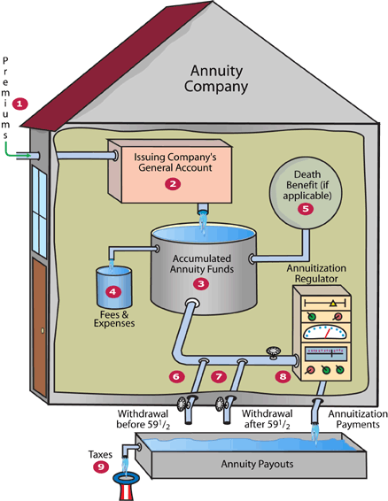
How a Fixed Deferred Annuity Works

Slide 21
Types of Annuity Contracts
Popular hybrid types of annuity products have been introduced into the fixed annuity market:
Equity-indexed annuity (EIA): a type of annuity that offers certain principal and earnings guarantees, but also offers the possibility of additional earnings by linking the contract to a published index
EIAs typically are classified as fixed annuities because of the guarantees they offer.
However, EIAs offer the potential for higher returns based on investment performance.

Slide 22
Types of Annuity Contracts
Market value adjusted (MVA) annuity: an annuity that offers multiple guarantee periods and multiple fixed interest rates
Rather than being “locked in” with fixed earnings for the life of the contract, contract owners can move or withdraw premium deposits at certain times specified in the contract to take advantage of prevailing market interest rates.
To be issued as fixed annuities in the United States, EIAs and MVA annuities must meet certain regulatory requirements.

Slide 23
Types of Annuity Contracts
Variable annuity: an annuity under which the amount of the accumulation value and the amount of the periodic income payments fluctuate in accordance with the performance of one or more specified investment funds
The insurer makes no guarantees regarding the principal, interest rate, or the amount of periodic income payments.
The contract owner rather than the insurer bears all the investment risk for a variable annuity.
Because of this investment risk transfer, U.S. federal laws treat variable annuities as securities that must comply with federal securities laws.

Slide 24
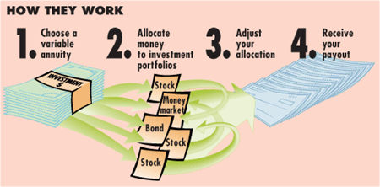
Variable Annuity

Slide 25
Variable Annuity
The mechanism that allows the transfer of risk from the insurer to the contract owner is the separate account, an investment account maintained separately from the insurer’s general account.
The insurer deposits funds placed in variable products, including variable annuities, into the separate account. The contract owner then has the right to
Select the subaccount(s)—the alternative investment funds within the insurer’s separate account—in which to invest premiums
Specify the percentage of each premium to be allocated to each subaccount

Slide 26
Variable Annuity
Transfer money among subaccounts
Change the percentage of money allocated to specific subaccounts
Change the subaccount in which future premiums are invested
Contract owners usually can place a portion of premium payments in a fixed subaccount, which guarantees payment of a fixed rate of interest for a specified period of time.
Unlike money invested in variable subaccounts, money invested in a fixed subaccount is held in the insurer’s general account.

Slide 27
Variable Annuity
At the beginning of the payout period, the variable annuity contract owner typically has the option of receiving periodic income payments that:
Are fixed in amount from a fixed subaccount
Fluctuate to directly reflect the investment experience of specified variable subaccounts
Are based on the results of some combination of fixed and variable subaccounts, so that a portion of the periodic income payments would be stable and another portion would fluctuate

Slide 28
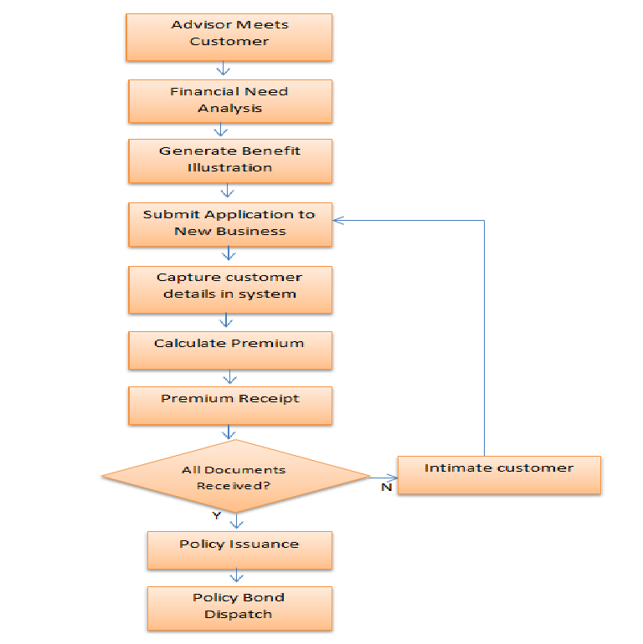
New Business Flow

Slide 29
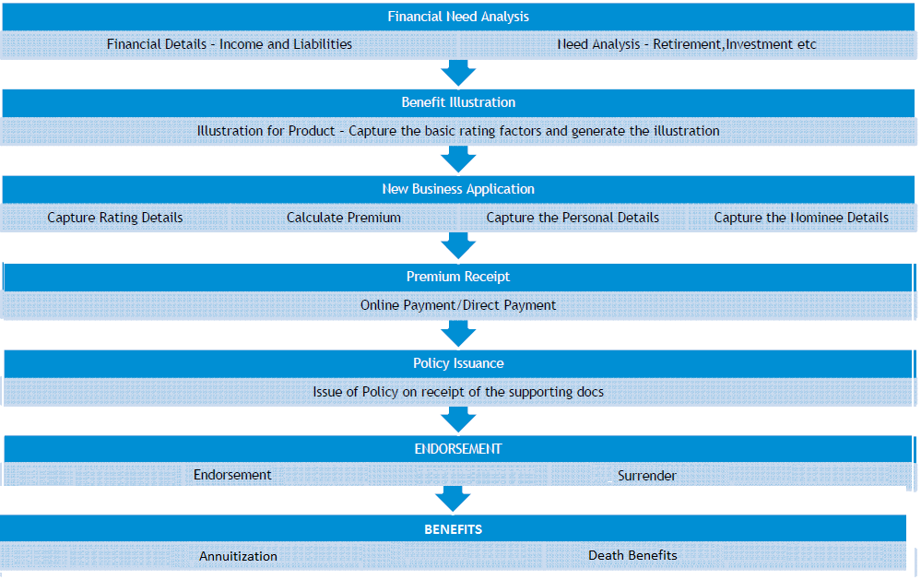
Annuity - Policy Life Cycle

Slide 30


